Slide 1

WELCOME

Slide 2
Data Communication
OEL Presentation
Topic Name :
Demonstrate an experiment for shift keying (ASK) and multiplexing (FDM) to communicate binary bits as analog signals; Demultiplex and convert them back into binary bits at the receiver.
Group 3 Section : B Spring 23-24
Supervised By: Dr. Shuvra Mondal

Slide 3

Presentators
Introduction and Purpose
Procedure
Simulation & result
Tonmoy Sutradhar 22-46568-1
NUR-E HABIB NURSHED 22-46568-1
MD. RAKIBUL ISLAM 22-46609-1
Impact on Society , health and safety(Society,
Health)
Impact on Society , health and safety(Safety ,
Culture)
Discussion and Conclusion
MARISHAT TASMIM 22-46386-1
TANJIL BIN MOHIUDDIN 22-47450-2
MD. SADMAN SHOPAN 21-45205-2

Slide 4

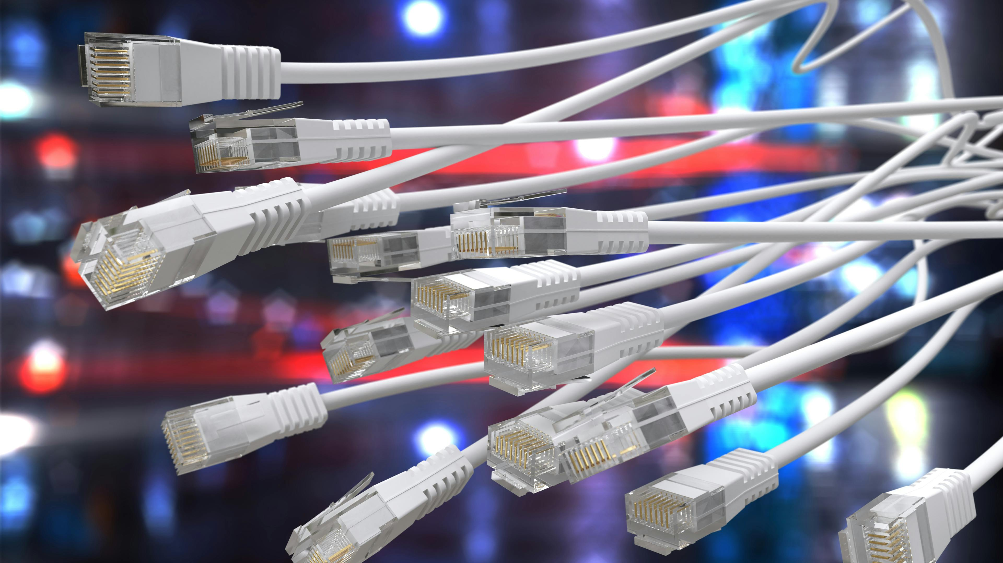

Slide 5
Introduction

Slide 7

Procedure

Slide 8
MD. RAKIBUL ISLAM 22-46609-1

Slide 9
Simulation

Slide 10
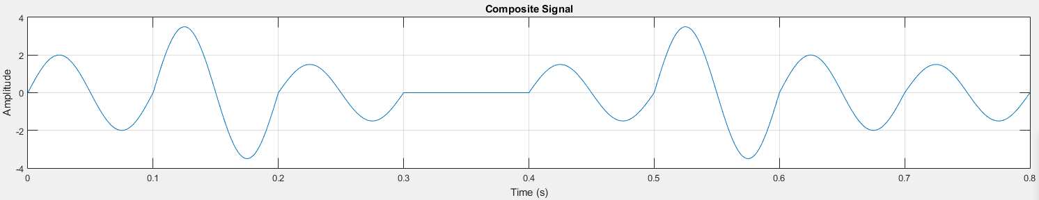
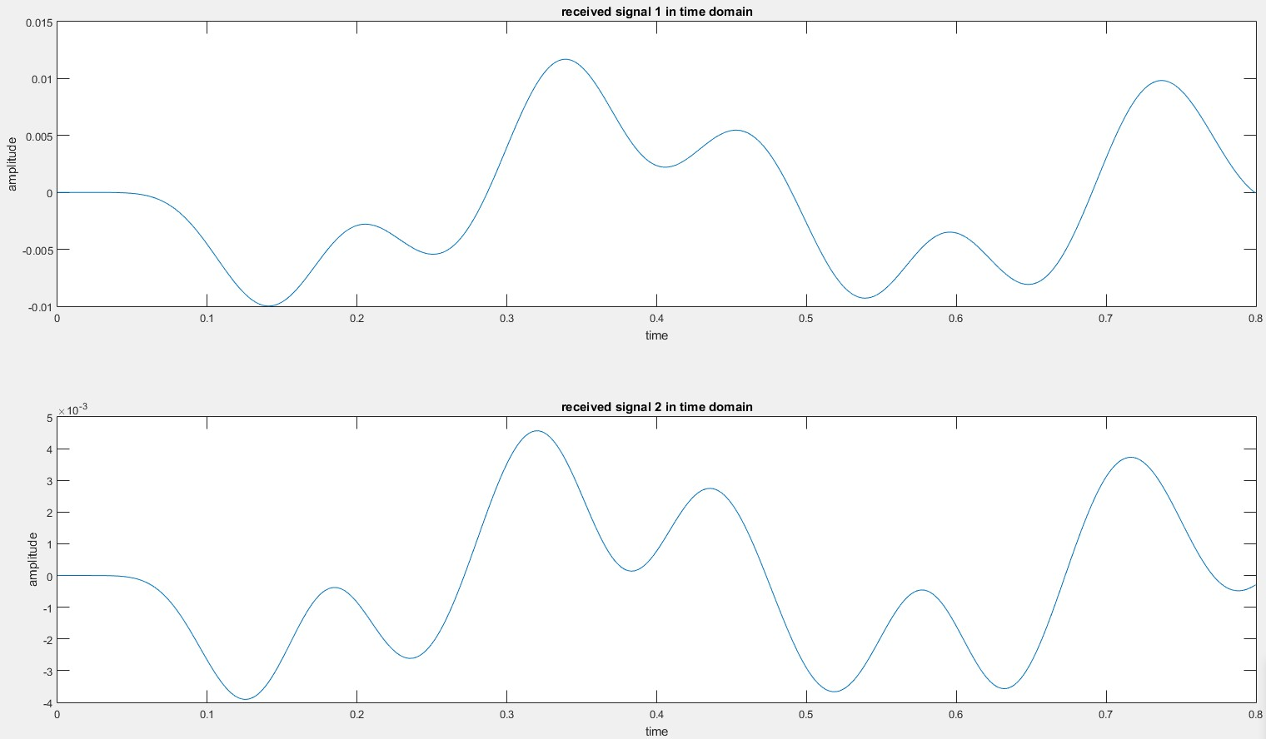
Result
Composite Signal Generation using FDM Multiplexing
Analog Signal Regeneration using FDM De-multiplexing

Slide 11
MARISHAT TASMIM 22-46386-1

Slide 12
Impact on Society, health & safety

Slide 13
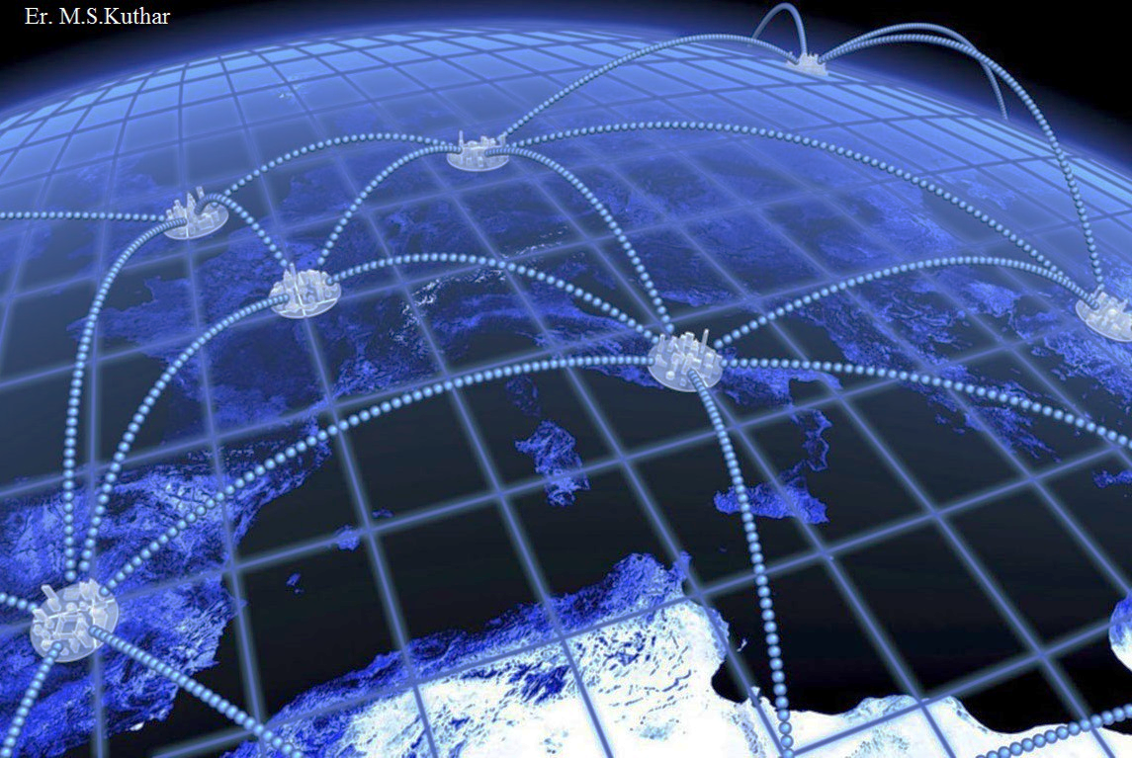
Impact on society
1.ASK & FDM have revolutionized communication, fostering global interconnectedness & cross culture dialogue . 2.Advancement of the internet has transformed how people communicate, work & access knowledge

Slide 14

Impact on health
Telemedicine enabled by ASK & FDM enhances healthcare accessibility, particularity in remote areas, reducing travel time & costs.
Remote diagnosis A treatment help mitigate the spread of contagious diseases in crowded medical facilities

Slide 15
TANJIL BIN MOHIUDDIN 22-47450-2

Slide 16

Impact on Safety and Culture

Slide 17
MD. SADMAN SHOPAN 21-45205-2

Slide 18
Discussion

Slide 19
Conclusion

Slide 20
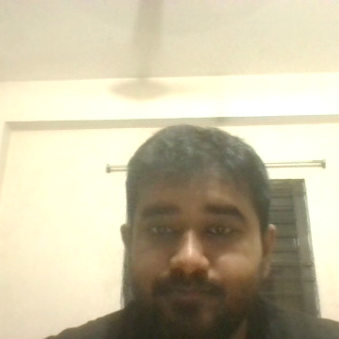
THANK YOU

